Slide 1
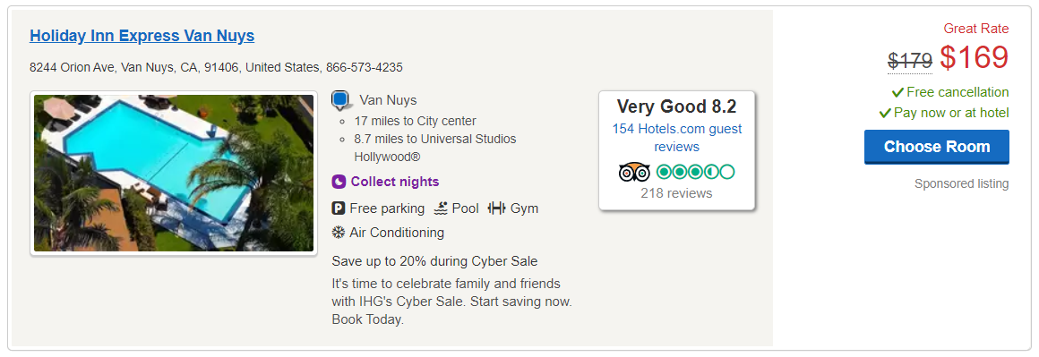

Slide 2
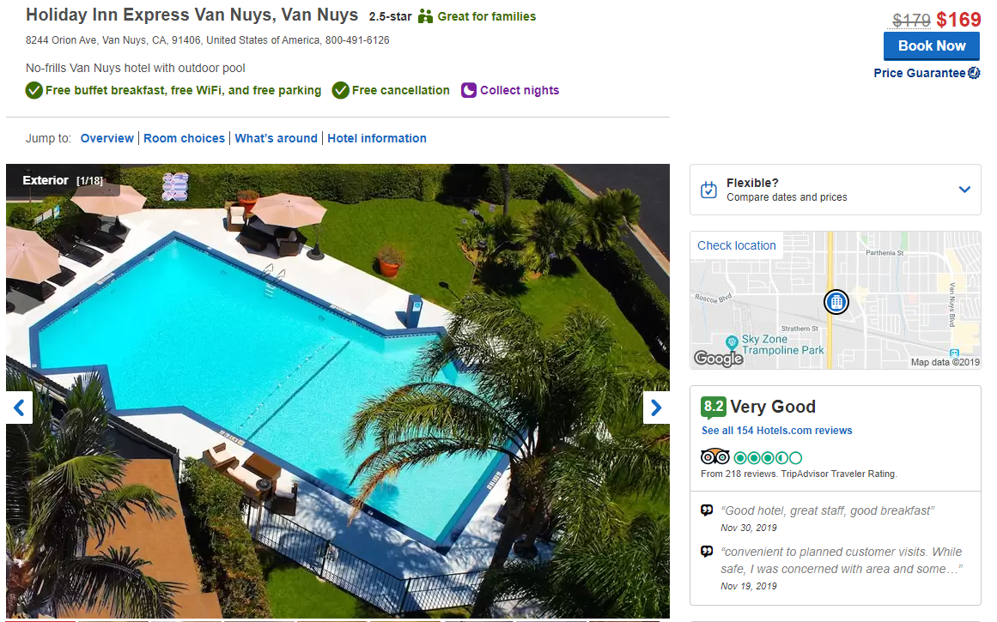

Slide 3
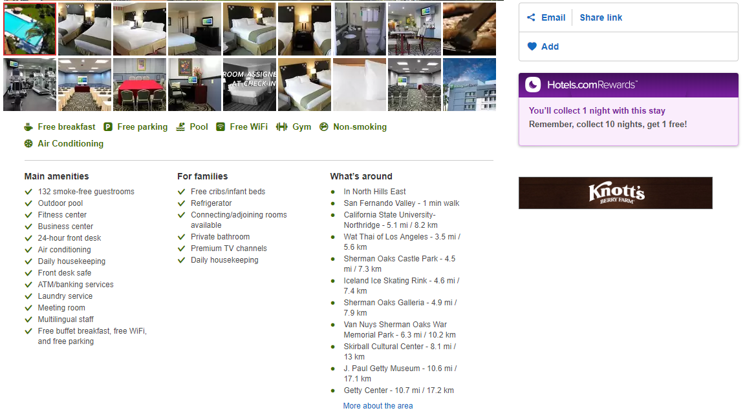

Slide 4
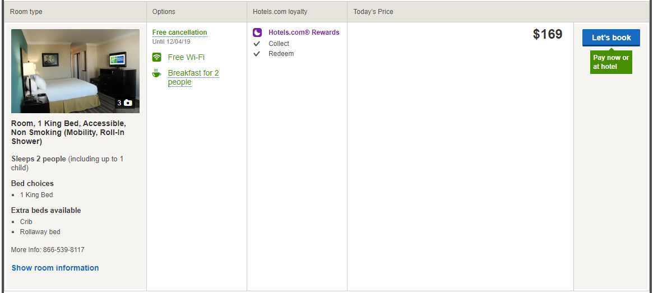

Slide 5
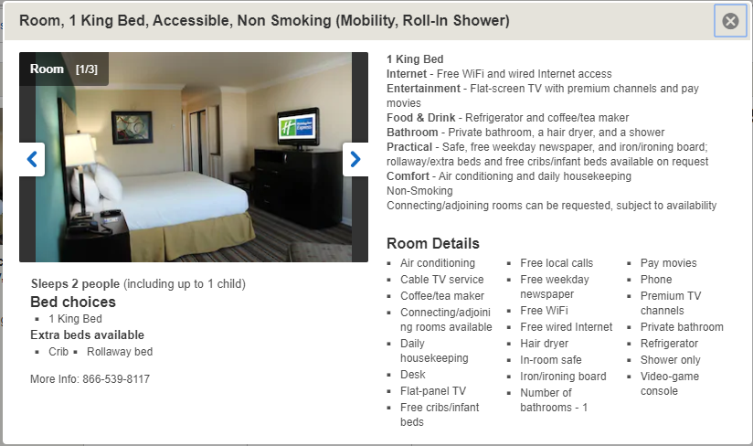

Slide 6
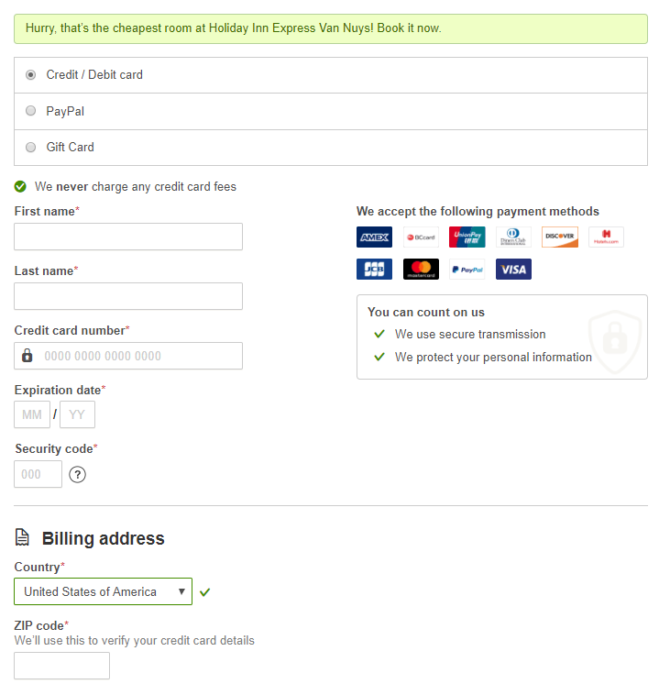

Slide 7
Entities
Main entities are:
Customer: Any individual or a group of individuals who wishes to book a hotel room for a particular date range. A customer can have favorite hotels.
Hotel: Any individual hotel or a group of hotels in a particular location. Every hotel has fixed number of rooms of a particular room type. Each room is associated with some amenities particular to that room like A/C, TV etc. There are also some shared amenities like swimming pool, parking, bar etc which are shared by all the customers.
Payment Type: Since it is an international website, it supports multiple payment methods, credit/debit card, PayPal or gift cards.
Tax Percentage: The tax depends on the location of the hotel.
Booking: Stores the booking details by a customer for a hotel. It is connected to the payment type entity to identify the payment method and the tax entity to identify the taxes for that particular location. The customer gets to know the room type but not the room number.
Amenities: There are 2 types of amenities, hotel amenities like swimming pool, parking, bar etc which are shared by all the customers and room amenities available for a particular room in a hotel like A/C, TV etc.
Room Type: A hotel can have multiple rooms of multiple kinds.
Offers: The website gives various offers on hotel bookings which have a start date and an expiry date.
Reviews: A customer can write reviews about one of more hotels.

Slide 8
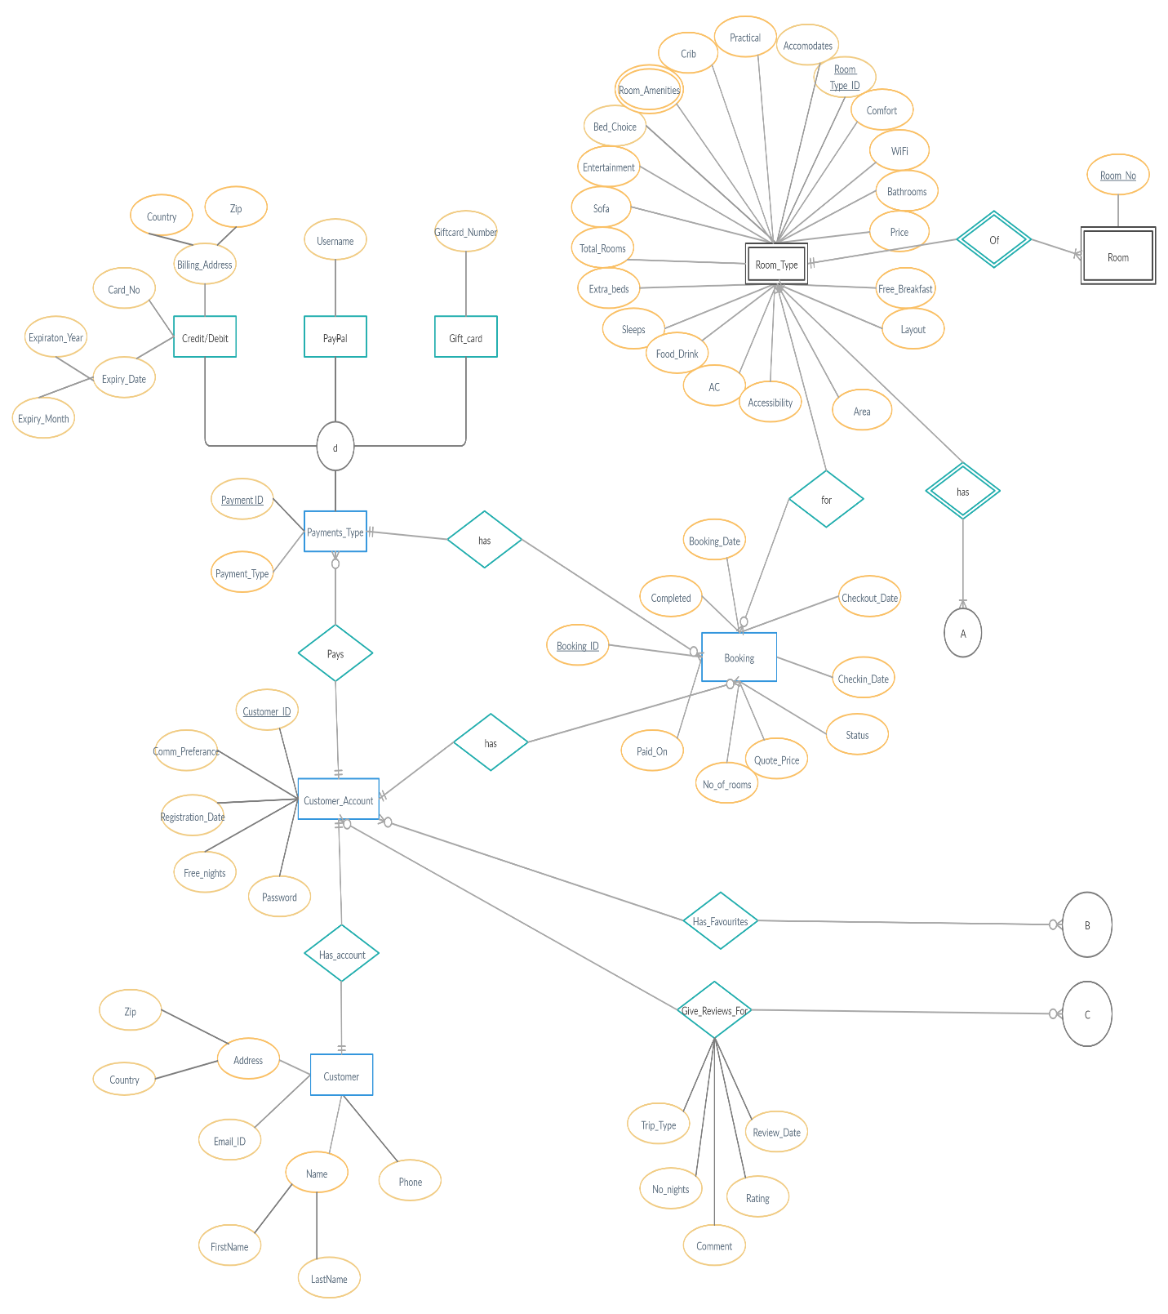

Slide 9
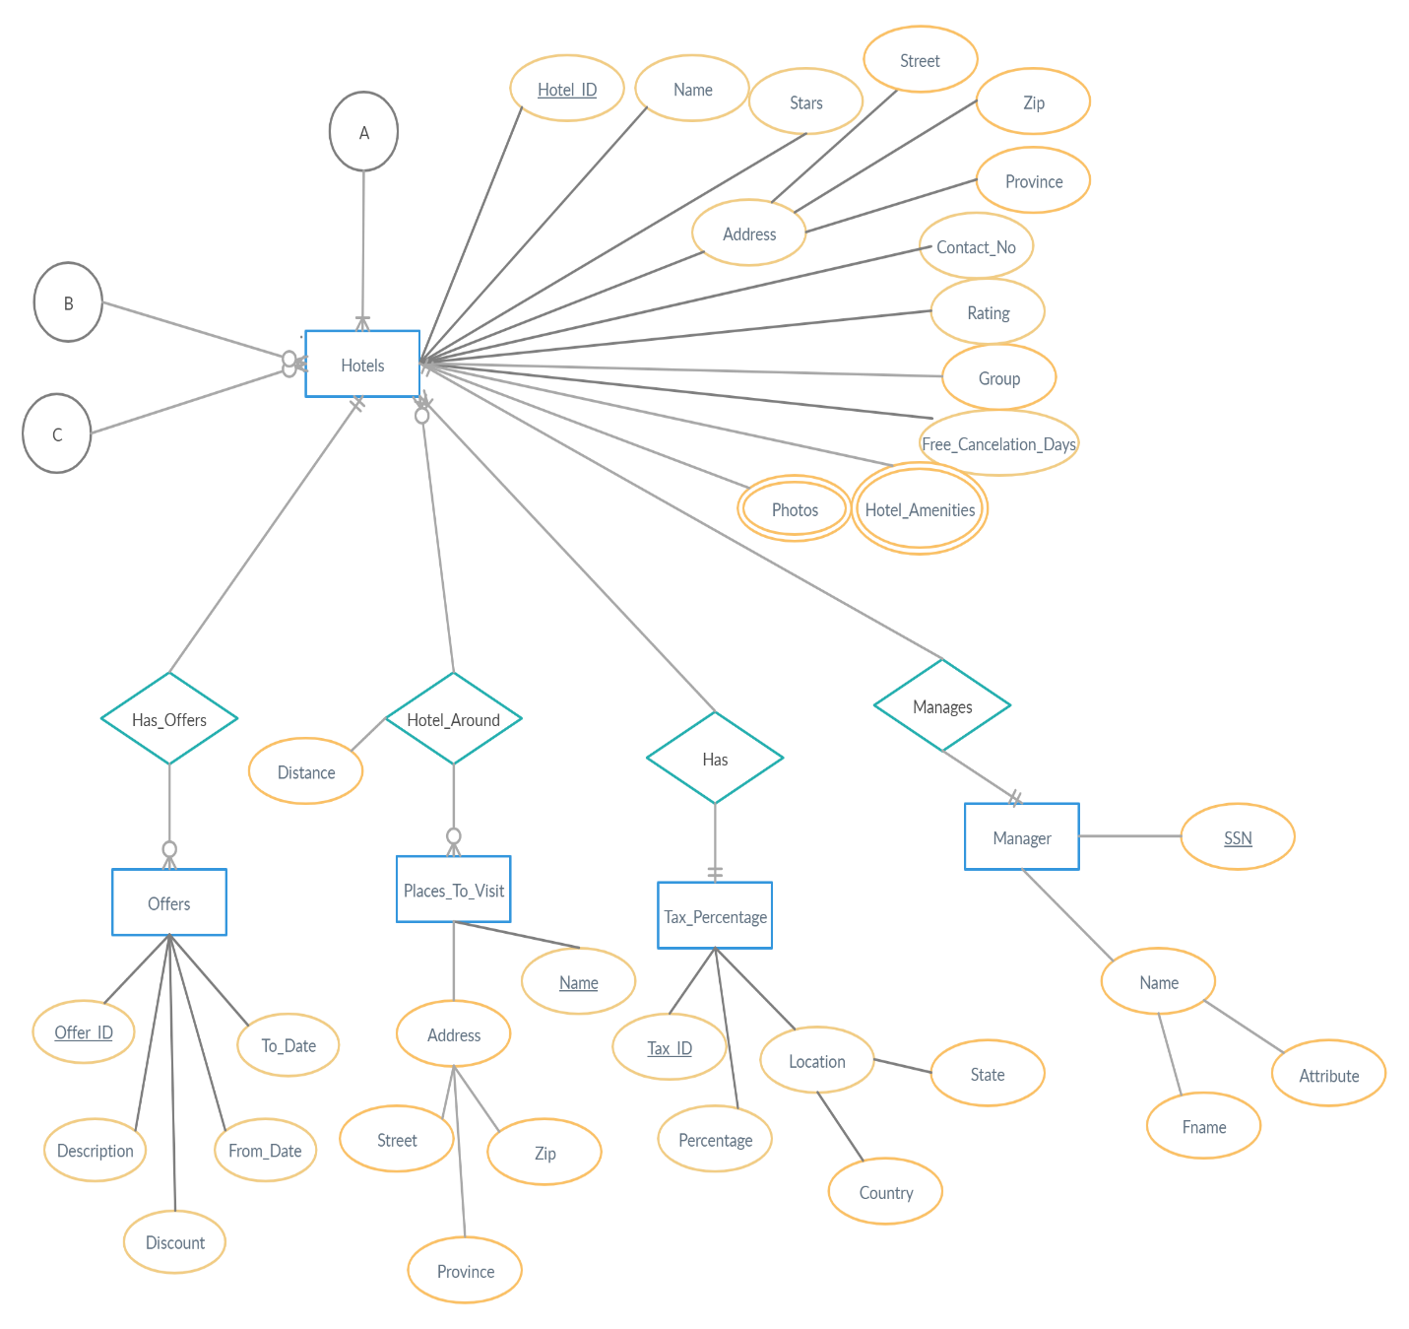

Slide 10
Summary of the relationships in the ER
1:1 Relationships
Customer and Customer_Account
Hotels and Manager
1:N Relationships
Hotels and Offers
Hotels and Tax_percentage
Customer_Account and Payments_Type
…….
M:N Relationships
Hotels and Places_to_visit
Customer_Account and Hotels (Has_Favourites)
Customer_Account and Hotels (Give_reviews_for)

Slide 11
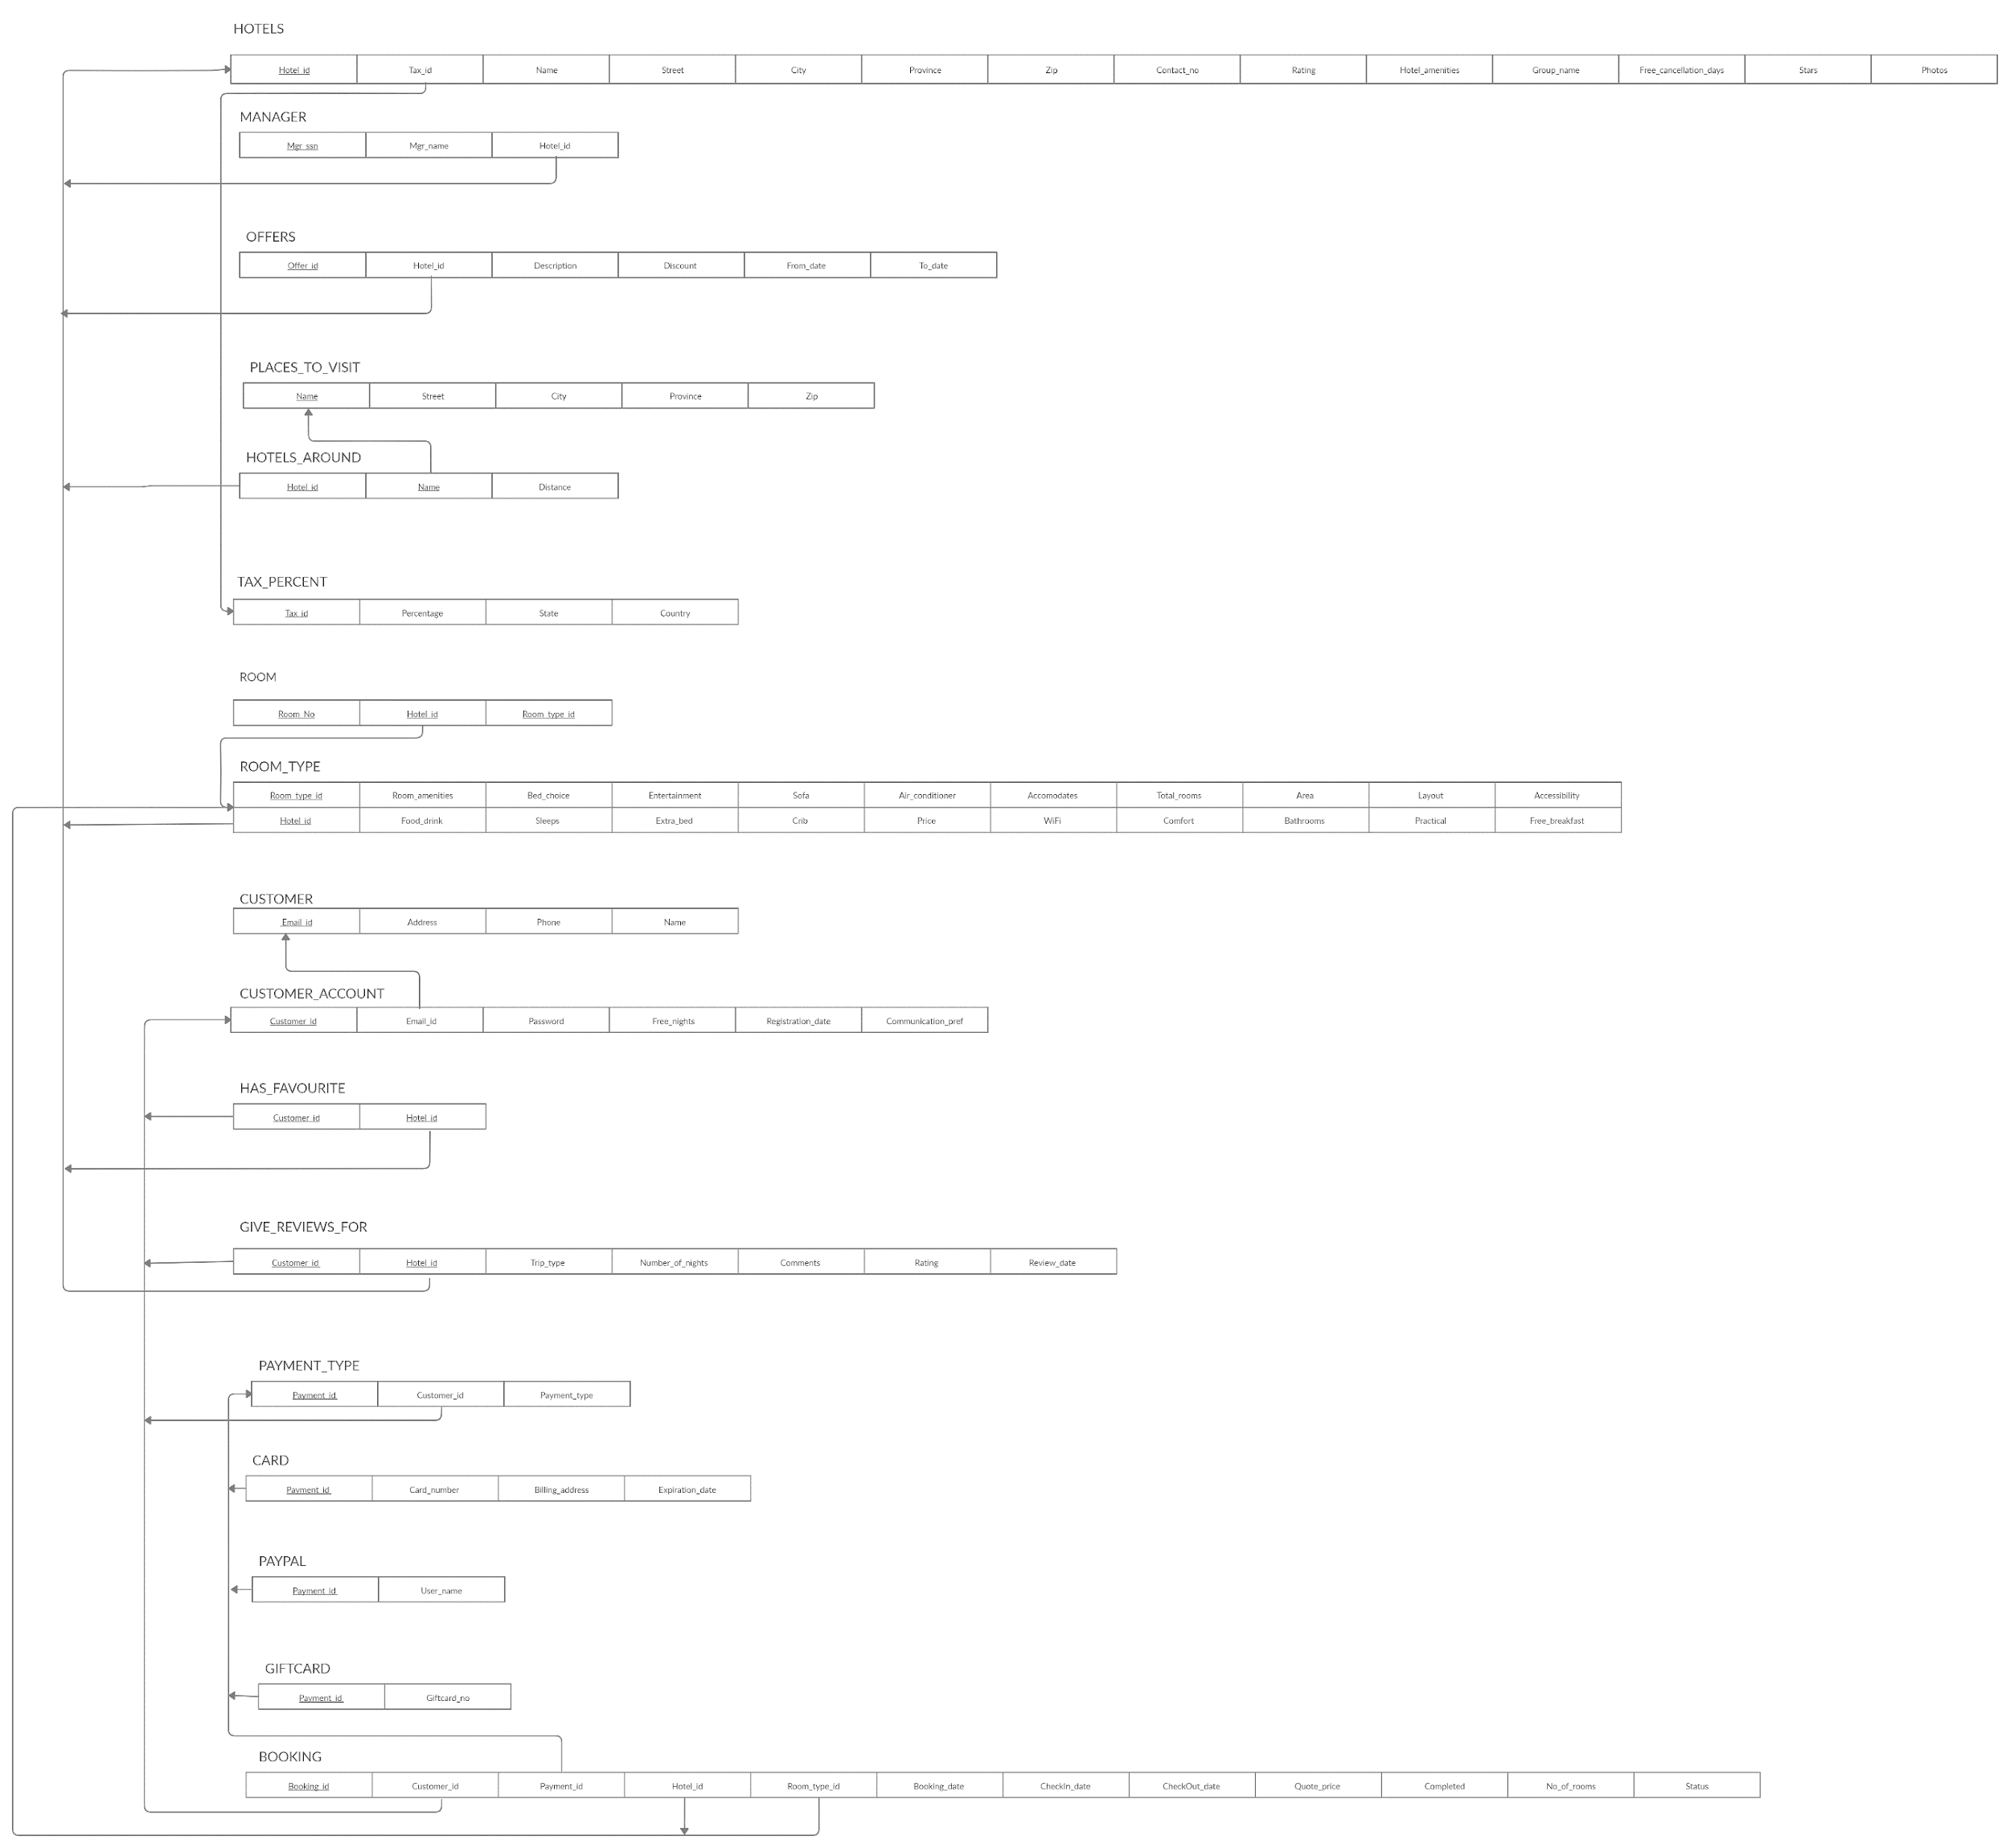
Before Normalization

Slide 12
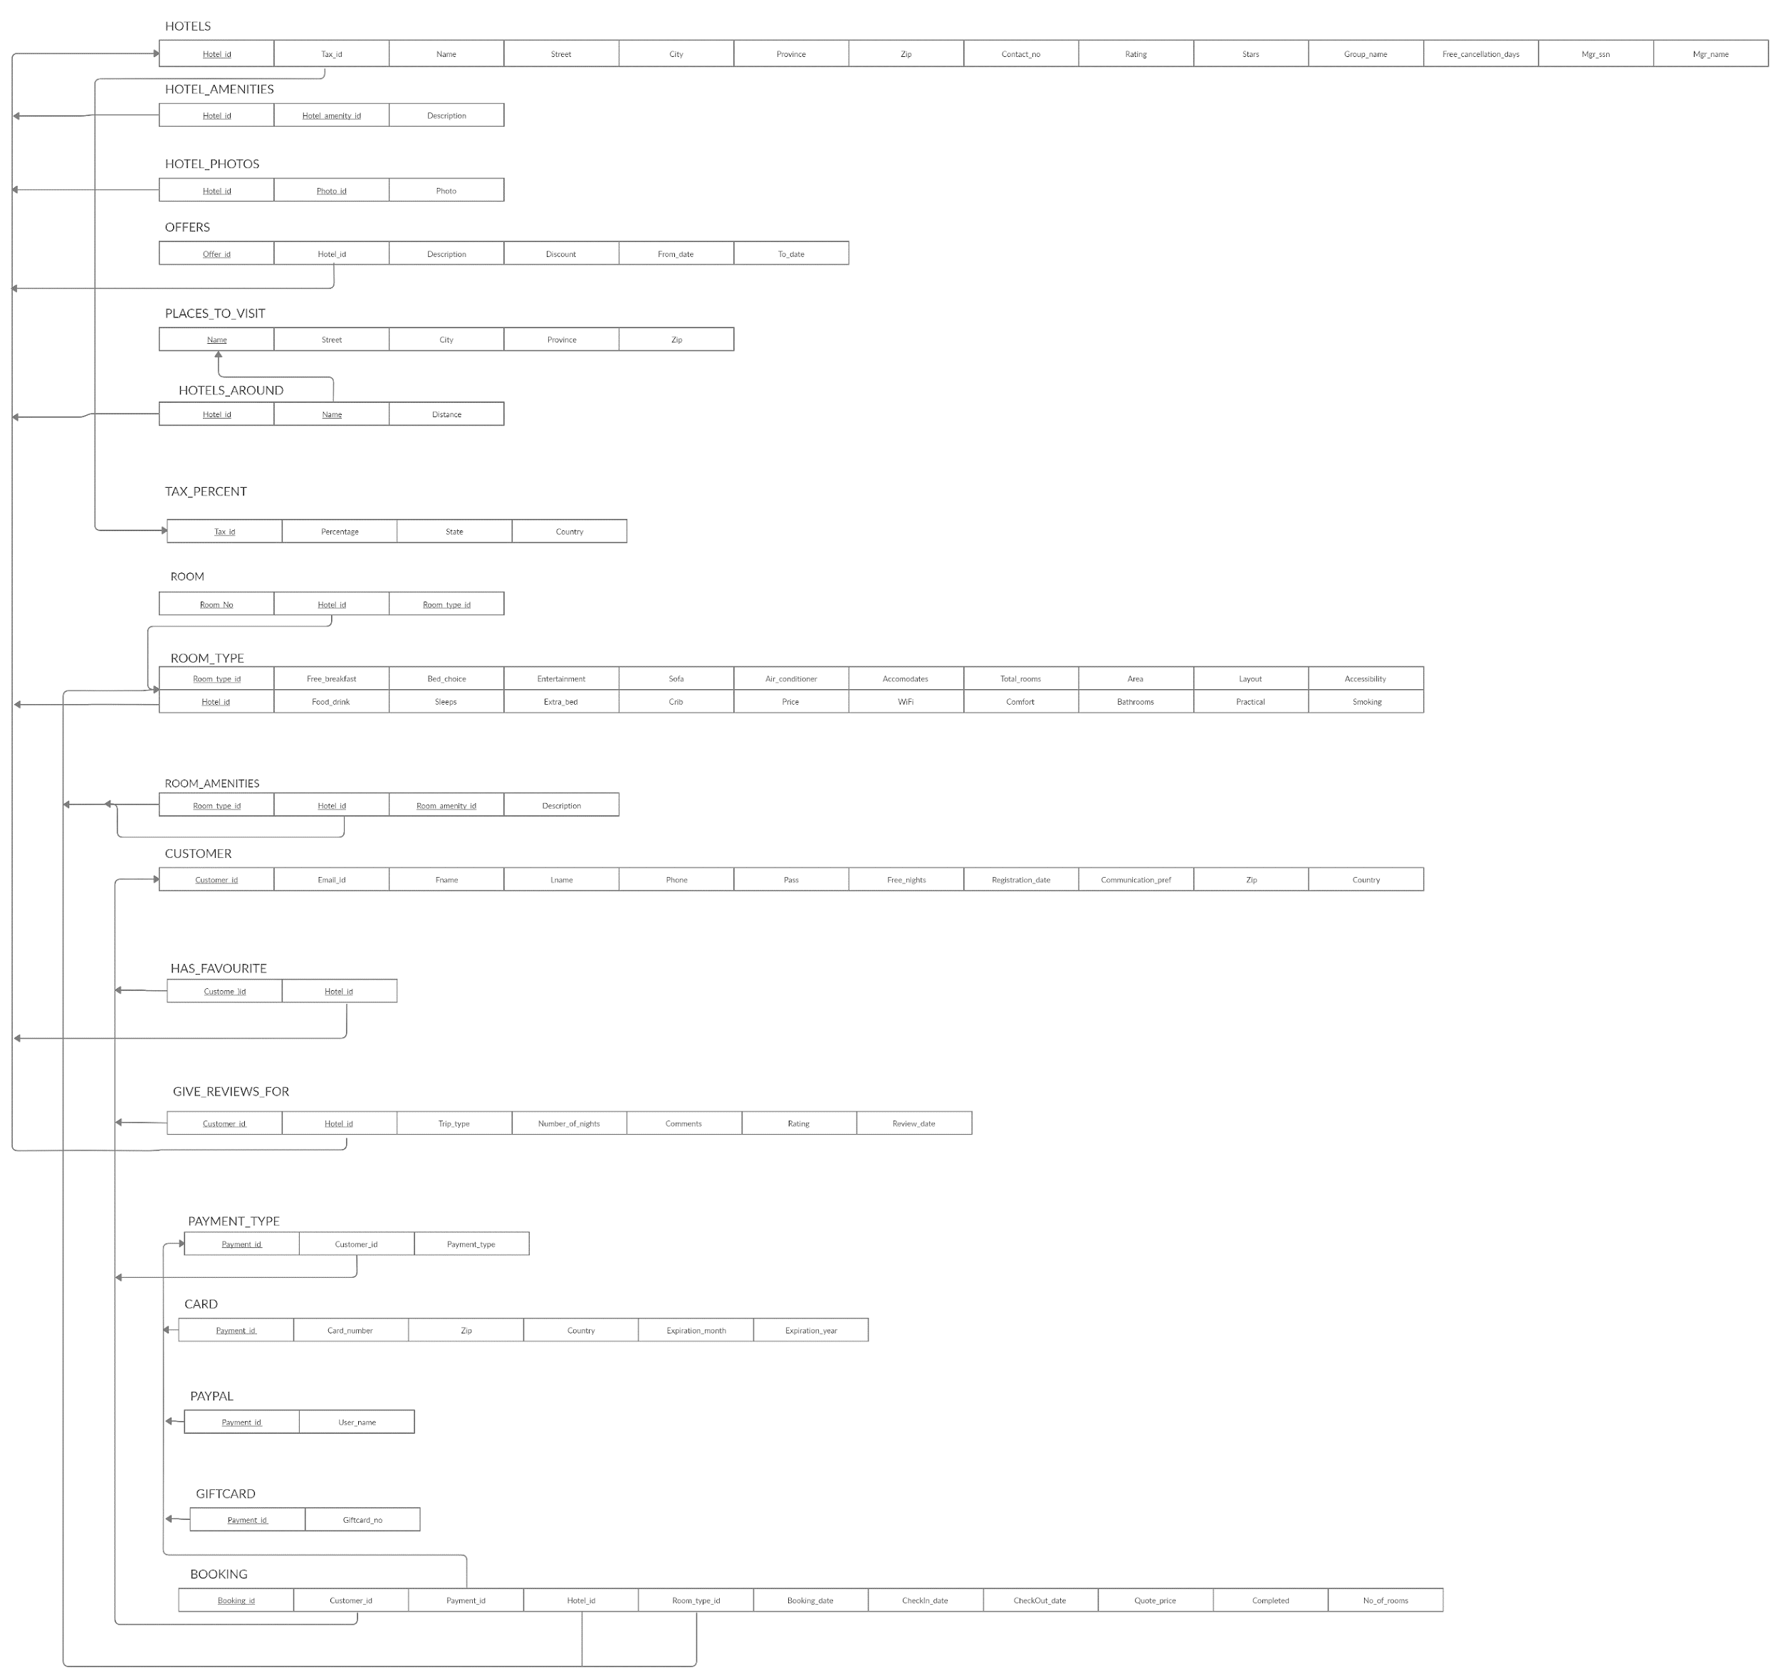
After Normalization

Slide 13
PL\SQL Triggers
Trigger to update the ratings of hotel
CREATE or REPLACE TRIGGER update_rating
AFTER INSERT ON Give_reviews_for
FOR EACH ROW
BEGIN
UPDATE Hotels SET rating= (SELECT AVG(rating) FROM Give_reviews_for WHERE Hotel_ID = :old.Hotel_ID);
END;

Slide 14
PL\SQL Triggers
Trigger to find distance between hotel and places to visit
CREATE or REPLACE TRIGGER cal_distance
AFTER INSERT ON Hotels_around
FOR EACH ROW
DECLARE
start_add varchar2(100);
end_add varchar2(100);
BEGIN
SELECT Street||city||province||zip FROM hotels INTO start_add WHERE hotel_id = old.hotel_id;
SELECT Street||city||province||zip FROM Places_to_visit INTO end_add WHERE hotel_id = old.name;
UPDATE Hotels_around SET distance = google_api.find_distance_between(start_add, end_add)
WHERE hotel_id=old.hotel_id AND name=old.name;
end;

Slide 15
PL\SQL Procedures
Procedure to add number of free nights
CREATE or REPLACE PROCEDURE add_free_nights AS
nights customer.free_nights%TYPE;
checkin booking.checkin_date%TYPE;
checkout booking.checkout_date%TYPE;
CURSOR c1 IS
SELECT c.free_nights, b.checkin_date, b.checkout_date
FROM customer c, booking b
WHERE b.customer_id=c.customer_id AND b.completed = 1;

Slide 16
BEGIN
OPEN c1;
LOOP
FETCH c1 INTO nights, checkin, checkout;
IF checkout >= sysdate-3 THEN
UPDATE customer
SET free_nights = (nights+checkout-checkin)/10;
END IF;
EXIT WHEN (c1%notfound);
end loop;
CLOSE c1;
END add_free_nights;

Slide 17
PL\SQL Triggers
Trigger to update the ratings of hotel
CREATE or REPLACE TRIGGER update_rating
AFTER INSERT ON Give_reviews_for
FOR EACH ROW
BEGIN
UPDATE Hotels SET rating= (SELECT AVG(rating) FROM Give_reviews_for WHERE Hotel_ID = :old.Hotel_ID);
END;

Slide 18
PL\SQL Function
Function to fetch user readable hotel rating based on average of previous ratings
CREATE or REPLACE FUNCTION hotel_ratings (hotel_id varchar2)
RETURN varchar2 AS
user_rating varchar2(20);
BEGIN
select case
when rating >= 9.0 then 'Loved by guests!'
else 'Enjoyed by guests.' end case
into user_rating from hotels h where h.hotel_id=hotel_id;
RETURN user_rating;
END;

Slide 19
PL\SQL Sequence
Sequence to auto-generate booking id
CREATE SEQUENCE booking_seq
START WITH 1000
INCREMENT BY 1
NOCACHE
NOCYCLE;

Slide 20
PL\SQL Procedure
Sequence to make booking
CREATE or REPLACE PROCEDURE make_booking
(Customer_id_ VARCHAR2, Payment_id_ VARCHAR2, Room_type_id_ VARCHAR2, hotel_id_ varchar2, checkin_ date, checkout_ date, offer_id_ varchar2, number_of_rooms_ int)
AS
number_of_days_ int;
discount_ float;
amount_ float;
free_nights_ int;
payment_result_ varchar2(20);
quote_price_ int;
tax_percent_ float;

Slide 21
BEGIN
number_of_days_ := checkout_ - checkin_;
select discount into discount_ from offers o where o.offer_id=offer_id_ and o.hotel_id=hotel_id_ and o.from_date<=checkin_ and o.to_date>=checkout_;
select floor(free_nights) into free_nights_ from customer where customer_id=customer_id_;
select price into quote_price_ from room_type where hotel_id=hotel_id_ and room_type_id=room_type_id_;
select percentage into tax_percent_ from tax_percentage where tax_id = (select tax_id from hotels where hotel_id = hotel_id_);
amount_ := (((number_of_days_ - free_nights_) * quote_price_) * (1 - discount_)) * (1+tax_percent_);
select make_payment (Payment_id_, amount_) into payment_result_ from dual;

Slide 22
if payment_result_ = 'Success'
then
update customer set free_nights = free_nights-free_nights_ where customer_id=customer_id_;
insert into booking(customer_id, hotel_id, payment_id, room_type_id, booking_date, checkin_date, checkout_date, quote_price, completed, no_of_rooms, status)
values (customer_id_, hotel_id_, payment_id_, room_type_id_, sysdate, checkin_, checkout_, amount_, null, number_of_rooms_, 'Success');
else
insert into booking(booking_id, customer_id, hotel_id, payment_id, room_type_id, booking_date, checkin_date, checkout_date, quote_price, completed, no_of_rooms, status)
values (booking_seq.nextval, customer_id_, hotel_id_, payment_id_, room_type_id_, sysdate, checkin_, checkout_, amount_, null, number_of_rooms_, 'Failure');
initiate_refund(booking_seq.currval);
end if;
END;

